Slide 1
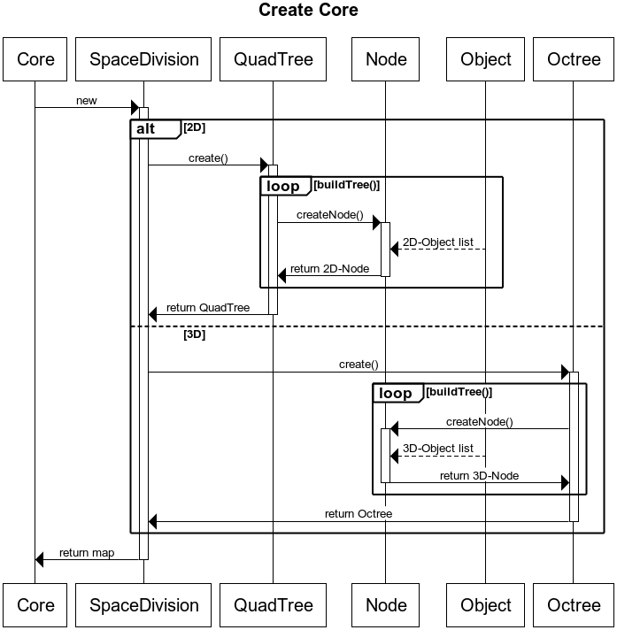
Create Core
title Create Core
Core->+SpaceDivision : new
alt 2D
SpaceDivision->+QuadTree : create()
loop buildTree()
QuadTree->+Node : createNode()
Object-->Node : 2D-Object list
Node->-QuadTree : return 2D-Node
end loop
QuadTree->-SpaceDivision : return QuadTree
else 3D
SpaceDivision->+Octree : create()
loop buildTree()
Octree->+Node : createNode()
Object-->Node : 3D-Object list
Node->-Octree : return 3D-Node
end loop
Octree->-SpaceDivision : return Octree
endSpaceDivision->-Core : return map

Slide 2
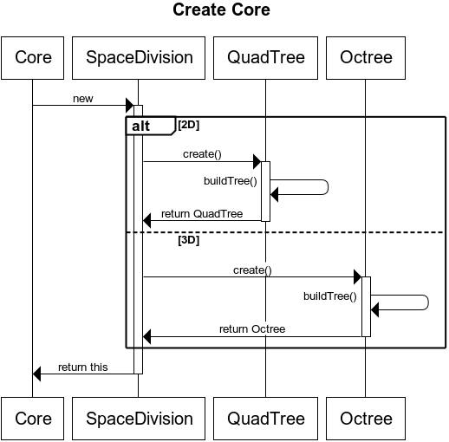
Create Core2
title Create Core
Core->+SpaceDivision : new
alt 2D
SpaceDivision->+QuadTree : create()
QuadTree->QuadTree : buildTree()
QuadTree->-SpaceDivision : return QuadTree
else 3D
SpaceDivision->+Octree : create()
Octree->Octree : buildTree()
Octree->-SpaceDivision : return Octree
End
SpaceDivision->-Core : return this

Slide 3
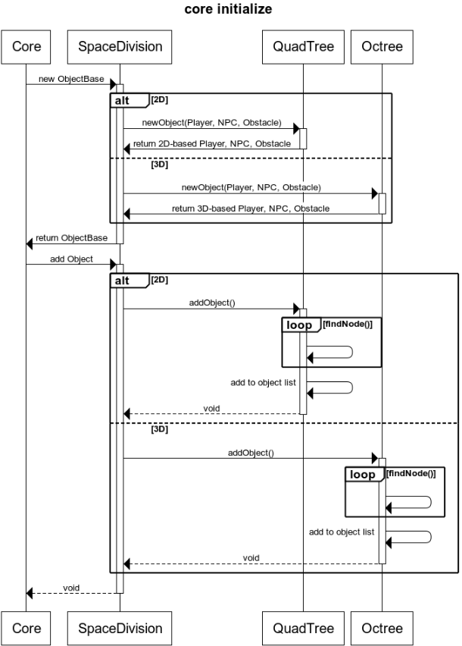
Core initialize
title core initialize
Core->+SpaceDivision : new ObjectBase
alt 2D
SpaceDivision->+QuadTree : newObject(Player, NPC, Obstacle) QuadTree->-SpaceDivision : return 2D-based Player, NPC, Obstacle
else 3D
SpaceDivision->+Octree : newObject(Player, NPC, Obstacle)
Octree->-SpaceDivision : return 3D-based Player, NPC, Obstacle
End
SpaceDivision->-Core : return ObjectBase
Core->+SpaceDivision : add Object
alt 2D
SpaceDivision->+QuadTree : addObject()
loop findNode()
QuadTree->QuadTree :
end
QuadTree->QuadTree : add to object list
QuadTree-->-SpaceDivision : void
else 3D
SpaceDivision->+Octree : addObject()
loop findNode()
Octree->Octree :
end
Octree->Octree : add to object list
Octree-->-SpaceDivision : void
End
SpaceDivision-->-Core : void

Slide 4
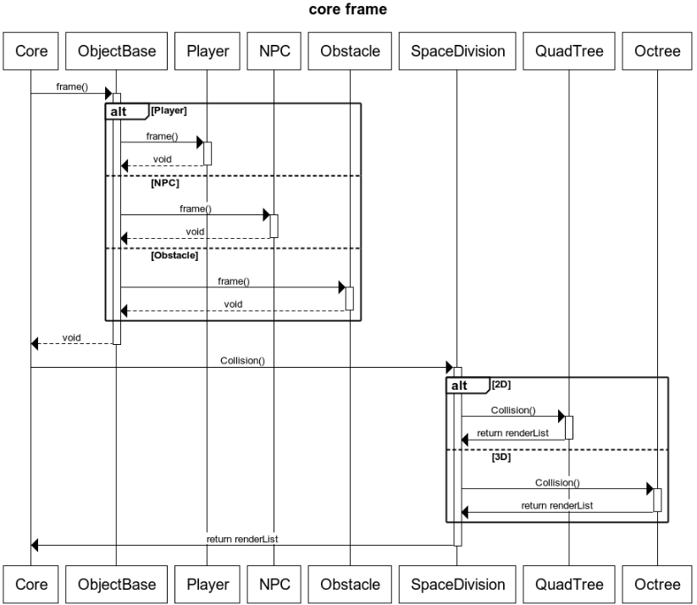
Core Frame
title core frame
Core->+ObjectBase : frame()
alt Player
ObjectBase->+Player : frame()
Player-->-ObjectBase : void
else NPC
ObjectBase->+NPC : frame()
NPC-->-ObjectBase : void
else Obstacle
ObjectBase->+Obstacle : frame()
Obstacle-->-ObjectBase : void
End
ObjectBase-->-Core : void
Core->+SpaceDivision : Collision()
alt 2D
SpaceDivision ->+QuadTree : Collision()
QuadTree ->-SpaceDivision : return renderList
else 3D
SpaceDivision ->+Octree : Collision()
Octree ->-SpaceDivision : return renderList
End
SpaceDivision ->-Core : return renderList

Slide 5
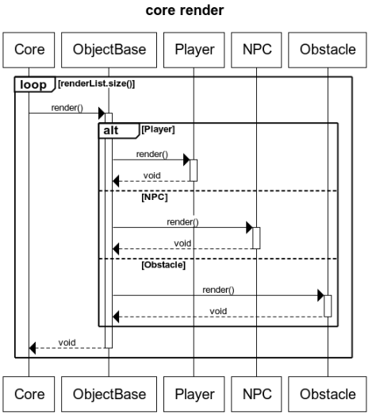
Core Render
title core render
loop renderList.size()
Core->+ObjectBase : render()
alt Player
ObjectBase->+Player : render()
Player-->-ObjectBase : void
else NPC
ObjectBase->+NPC : render()
NPC-->-ObjectBase : void
else Obstacle
ObjectBase->+Obstacle : render()
Obstacle-->-ObjectBase : void
End
ObjectBase-->-Core : void
end

Slide 6
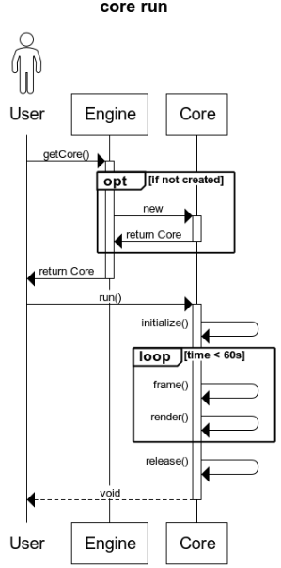
Core run
title core run
actor User
User->+Engine : getCore()
opt if not created
Engine->+Core : new
Core->-Engine : return Core
End
Engine->-User : return Core
User->+Core : run()
Core->Core : initialize()
loop time < 60s
Core->Core : frame()
Core->Core : render()
End
Core->Core : release()
Core-->-User : void

Slide 7
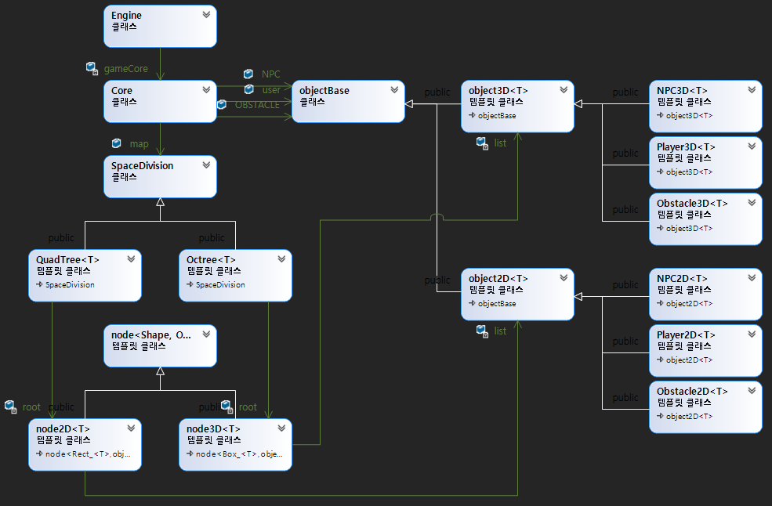
클래스 다이어그램 캡쳐본
1

